Slide 1
ICT453: Internet Technologies & Web Design
JavaScript I
Ghana Telecom University College
Lecturer - Lempogo Forgor
2013

Slide 2
Client-Side Programming
HTML is good for developing static pages
can specify text/image layout, presentation, links, …
Web page looks the same each time it is accessed
in order to develop interactive/reactive pages, must integrate programming in some form or another
client-side programming
programs are written in a separate programming (or scripting) language
e.g., JavaScript, JScript, VBScript
programs are embedded in the HTML of a Web page, with (HTML) tags to identify the program component
e.g., <script type="text/javascript"> … </script>
the browser executes the program as it loads the page, integrating the dynamic output of the program with the static content of HTML
could also allow the user (client) to input information and process it, might be used to validate input before it’s submitted to a remote server

Slide 3
Scripts vs. Programs
A scripting language is a simple, interpreted programming language:
scripts are embedded as plain text, interpreted by application
simpler execution model: don't need compiler or development environment
saves bandwidth: source code is downloaded, not compiled executable
platform-independence: code interpreted by any script-enabled browser
but: slower than compiled code, not as powerful/full-featured

Slide 4
Common Scripting Languages
JavaScript: the first Web scripting language, developed by Netscape in 1995
syntactic similarities to Java/C++, but simpler, more flexible in some respects,
limited in others
(loose typing, dynamic variables, simple objects)
JScript: Microsoft version of JavaScript, introduced in 1996
same core language, but some browser-specific differences
fortunately, IE, Netscape, Firefox, etc. can (mostly) handle both JavaScript & JScript
VBScript: client-side scripting version of Microsoft Visual Basic

Slide 5
Common Scripting Tasks
adding dynamic features to Web pages
validation of form data (probably the most commonly used application)
image rollovers
time-sensitive or random page elements
handling cookies
defining programs with Web interfaces
utilize buttons, text boxes, clickable images, prompts, etc

Slide 6
Limitations of Client-side Scripting
since script code is embedded in the page, it is viewable to the world
for security reasons, scripts are limited in what they can do
e.g., can't access the client's hard drive
since they are designed to run on any machine platform, scripts do not contain platform specific commands
script languages are not full-featured
e.g., JavaScript objects are very crude, not good for large project development

Slide 7
JavaScript
JavaScript is a web programming language that you can use with HTML5.
HTML5 defines your web pages content.
CSS defines the presentation of your web pages.
JavaScript defines special behavior for the page.
JavaScript has nothing to do with Java. They are two completely different and unrelated languages.
Notes:
Although many new HTML5 elements support features that no longer require the developer to employ JavaScript, it can used to access certain parts of your web pages written in HTML5 and do other things that simply cannot be done without JavaScript.

Slide 8
Types of JavaScript
There are two primary types of scripts
External JavaScript
JavaScript that is loaded from an external file (in text-only format)
Internal/Embedded JavaScript
JavaScript that is embedded in a web page.
It is the same concept as external and embedded style sheets.

Slide 9
Types of JavaScript
As with CSS, its generally better to load scripts from an external file than to embed them in your markup.
The src attribute of the script element references the script’s URL.
Notes:
You’ll reap some of the same benefits, in that a single JavaScript tile can be loaded by any number of pages that need it. You can edit one script rather than updating similar scripts in a number of individual pages of markup.

Slide 10
How A Browser Handles Scripts
As a page loads, by default the browser downloads parses, and executes each script in the order in which it appears in the markup.
blocking behavior
When a script is being processed, the browser neither downloads nor renders any content that appears after the script element – not even text.
This can really impact the rendering speed of pages, depending on the size of the script and what actions it performs
To avoid blocking behavior
put all script elements at the end of your markup, right before the </body> end tag.
Notes:
As you can imagine, it can really impact the rendering speed of your page, depending on the size of the script and what actions it performs.
Most browsers do this because you JavaScript may include code on which another script relies, code that generates content immediately, or code that otherwise alters your page.
Browsers need to take all of that into account before they finish rendering your page

Slide 11
How A Browser Handles Scripts
Another way to speed up script loading is to combine all your JavaScript into a single file, or as few as possible, and then minify the code.
minified code contains no line breaks, comments, or any extra whitespace.
If you’d like to try minifying your JavaScripts you can use the following:
Google Closure Compiler:
download & documentation at: http://code.goggle.com/closure/compiler
online version at: http://closure-compiler/appspot.com
YUI Compressor:
download & documentation at: http://developer.yahoo.com/yui/compressor
(unofficial) online version at: http://refresh-sf-com/yui

Slide 12
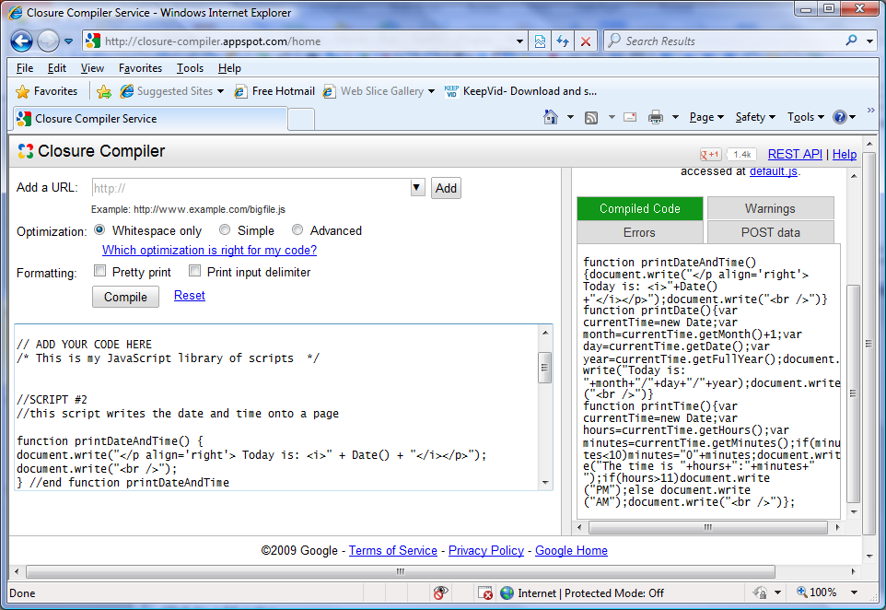
Screen shot illustrating Google Closure Compiler and output removing all whitespace from the script.

Slide 13
It is a preferred practice that the script appears just before the </body> tag
Adding An Embedded Script
<body>
<script type="text/javascript">
javascript statements
</script>
</body>
<body>
<script language="JavaScript">
javascript statements
</script>
</body>

Slide 14
Adding An Embedded Script
<!DOCTYPE html>
<html lang="en">
<head> <title> JavaScript Example 1</title>
<style type="text/css">
h1{ font-size:30pt; text-align:center;font-style:italic;background:blue; }
</style>
</head><body>
<header><h1 > Here is the heading of the Page</h1></header>
<nav>
<ul><li> <a href="#"> Link 1 </a> </li><li> <a href="#"> Link 2 </a> </li>
<li> <a href="#"> Link 3 </a> </li><li> <a href="#"> Link 4 </a> </li></ul>
</nav>
<script type="text/javascript">
window.alert("A web browser will follow your instructions exactly without an argument.");
</script>
</body>
</html>

Slide 15
Adding An External Script
To work with external script, the script should be written in a file and saved with .js extension. eg. basicscript1.js.
The javaScript file will then be linked to the HTML file using the <script> tag and the src attribute:
We could write the following code and save it as basicscript1.js and call in the HTML page
<body>
<script src=“basicscript1.js”> </script>
</body>
window.alert("A web browser will follow your instructions exactly wiout an argument.");

Slide 16
Adding An External Script
<!DOCTYPE html>
<html lang="en">
<head> <title> JavaScript Example 1</title>
<style type="text/css">
h1{ font-size:30pt; text-align:center;font-style:italic;background:blue; }
</style>
</head><body>
<header><h1 > Here is the heading of the Page</h1></header>
<nav>
<ul><li> <a href="#"> Link 1 </a> </li><li> <a href="#"> Link 2 </a> </li>
<li> <a href="#"> Link 3 </a> </li><li> <a href="#"> Link 4 </a> </li></ul>
</nav>
<script src="basicscript1.js"> </script>
</body>
</html>

Slide 17
How To Really Use JavaScript
In both of those examples, the execution of the script was automatic
The real power of JavaScript in HTML5 can be better seen when the script waits until the visitor does something to launch the script.
For example
if the visitor clicks something, you can launch any script you want.
Do to this you use an HTML5 event handler.

Slide 18
HTML5 Event Handlers
An HTML5 event handler allows the page to detect that some kind of action (an event) as occurred and has a built-in function that recognizes the event.
HTML5 recognizes a lot of different events.
Some of the events occur automatically – such as when the page loads.
Other events occur when visitors do something with the mouse or keyboard.

Slide 19
HTML5 Event Handlers
onchange | onclick | ondbleclick | ondrag | ondragend
ondrageneter | ondragleave | ondrageover | ondragstart | ondrop
onkeydown | onkeypress | onkeyup | onmousedown | onmousemove
onmouseout | onmouseover | onmouseup | onmousewheel | onpause
onplay | onplaying | onprogress | onloadstart | onload
A sample of HTML5 event handlers

Slide 20
HTML5 Event Handlers
The general format of all events linked to elements is:
<element onEvent = “javascriptFunction()”>
An example might be:
<body onLoad = “announceSomething()”>
The example above would use the body element with an onLoad event handler to fire a JavaScript function named announceSomething().

Slide 21
Detecting Events - JavaScript
function detectLoaded()
{
alert("Page is Loaded");
}
function detectClick()
{
alert("You Clicked a Link");
}
function detectDoubleClick()
{
alert("You Double-Clicked another Link");
}

Slide 22
Detecting Events - HTML
<!DOCTYPE html>
<html lang="en"> <head> <title> JavaScript Example 1</title>
<style type="text/css">
body{background-color:yellow; }
a {text-decoration:none;color:#060; }
h1{font-size:30pt;text-align:center;font-style:italic;background:blue;}
</style>
<script src="jav2.js"></script>
</head>
<body onLoad="detectLoaded()">
<hgroup>
<h1 > <a href="#" onClick="detectClick()"> Click This Please</a></h1>
<h2 > <a href="#" onDblClick="detectDoubleClick()"> Double-Click This Please</a></h2>
</hgroup>
</body>
</html>

Slide 23
Event Bubbling
The previous example doesn’t use anything that is new to HTML5.
In HTML5 you can set up an event handler in any element.
The following example illustrates events in <p>, <header>, and <article> elements.

Slide 24
Event Bubbling - JavaScript
function showP()
{
alert("You just Clicked withing an <p> container");
}
function showArticle()
{
alert("You just Clicked withing an <article> container");
}
function showHeader()
{
alert("You just Clicked withing an <Header> container");
}

Slide 25
Event Bubbling - HTML
<!DOCTYPE html>
<html lang="en"><head><title> JavaScript Example 1</title>
<style type="text/css">
body {background-color:grey;}
p{font-family:sans-serif;color:#ff0;font-size:24pt;text-align:center;
font-style:italic;background:#00f;}
</style>
<script src="jav2.js"></script>
</head><body>
<article onClick="showArticle()">
<header onClick="showHeader()">
<h1 > This is the Element in the H1 Header Click This Please</h1>
</header> <section>
<p onClick="showP()"> Click this Paragraph</p>
This is just some plain text in the article container, Click here just to see what happens.
</section> </article> </body> </html>

Slide 26
Event Bubbling
As soon as the visitor clicked on the line “Click This Paragraph” the event is reported (they clicked in the <p> container)
When the visitor clicks the OK button in the JavaScript pop-up, the second alert appears letting them know that they had clicked in the <article> container as well.
One way of looking at the events is bubbling up, beginning in the lowest level in the hierarchy (nesting of elements) and then bubbling up to the topmost level of the hierarchy.
In this example, the hierarchy, from lowest level to highest, is represented by <p>, (<section>, <header>), <article>, <body>

Slide 27
The Document Object Model
The Document Object Model (DOM) for HTML5 represents a hierarchy tree.
At the root of every web page or document is the <html> element, and the rest of the elements in the page are a branch somewhere along the tree.
JavaScript uses the DOM for addressing and manipulation a web page beyond what you can do with HTML5 alone.
The entire DOM tree is a representation of the document that resides in your computer’s memory.

Slide 28
The Document Object Model
When any part of the DOM tree is addressed, it does so by referencing an element within the tree, beginning with document.
Each element in the tree is addressed in order of the hierarchy beginning with document.
The different elements in a web page are the different properties or methods (built-in functions) of the document separated by a dot (.).

Slide 29
The Document Object Model
For example
document.forms.signup;
This would address a form named signup within a document.
A built-in function that does something with the document would appear as:
document.write(“this is some text.”);
The window root along with the document has several built-in functions that are useful for manipulating viewing areas of a web page.

Slide 30
Viewing A Document’s DOM Tree
Current browsers provide developer tools that can display a visual representation of a document’s DOM tree.
Browser | Command to display developer tools
Chrome | Windows/Linux: Control + Shift + i Mac OS X: Command + Option + i
Firefox | Windows/Linux: Control + Shift + i Mac OS X: Command + Option + i
IE | F12
Opera | Windows/Linux/Mac OS X: From View on tool bar select Developer Tools then select Opera DragonFly (Control + Shift + i)
Safari | Windows/Linux/Mac OS X: From Edit/Preferences/Advanced check “Show develop menu in menu bar” – then select as needed
NOTE:
For FireFox, you must first install the DOM Inspector add-on available at: https://addons/mozilla/org/en-US/firefox/addon/dom-inspector-6622/.

Slide 31
Viewing A Document’s DOM Tree
<!DOCTYPE html>
<html lang="en">
<head>
<title> Basic DOM Tree Demonstration</title>
</head>
<body>
<h1> An HTML5 Page </h1>
<p> This page contains some basic HTML5 elements. The DOMTree of the document contains a DOM node for every element</p>
<p> Here is an unordered list:</p>
<ul>
<li> ICT 112 </li>
<li> ICT 233 </li>
<li> ICT 235 </li>
</ul>
</body>
</html>

Slide 32
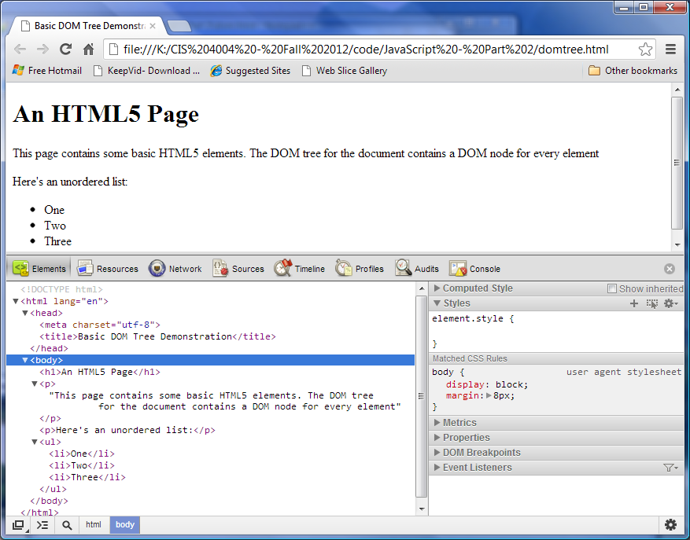
Chrome Example

Slide 33
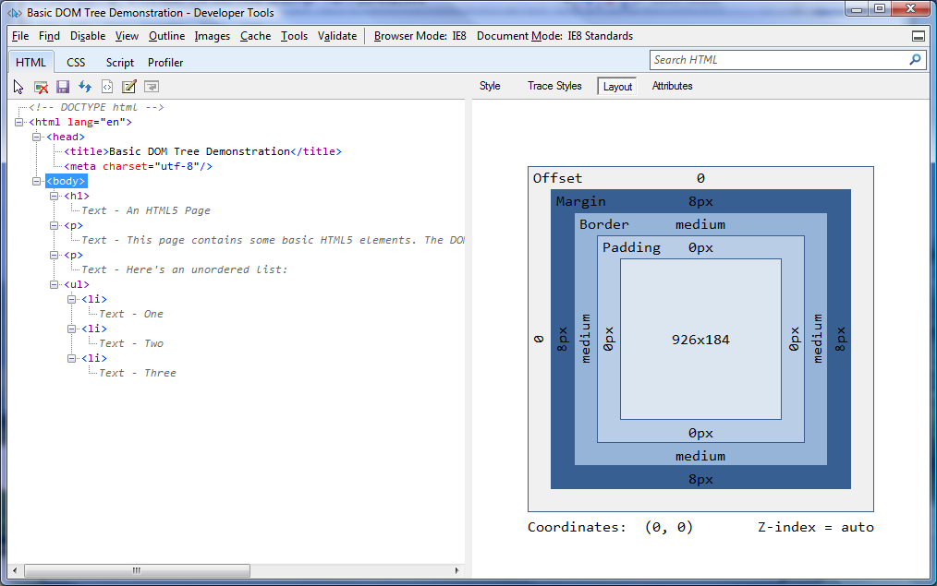
Internet Explorer Example

Slide 34
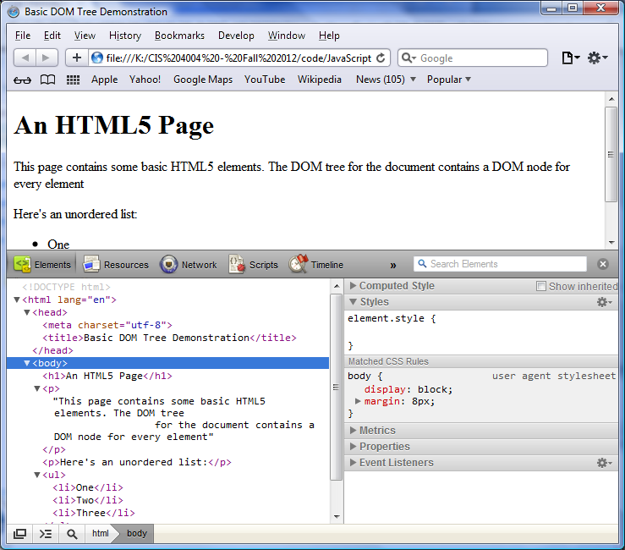
Safari Example

Slide 35
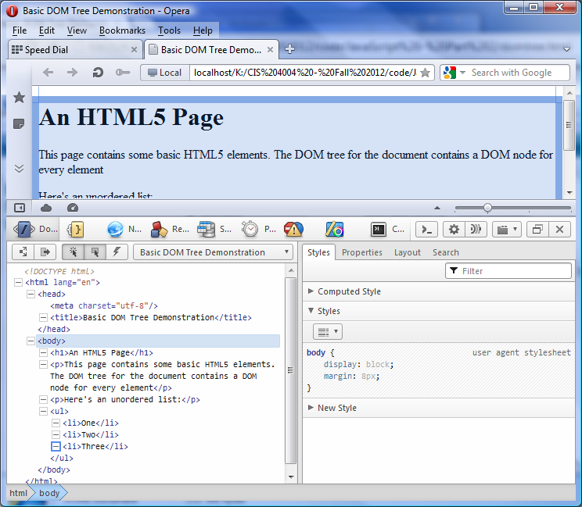
Opera Example

Slide 36
Viewing A Document’s DOM Tree
A node in the DOM tree can be expanded and collapsed using the ► and ▼ arrows next to a given node.
The html node is the root of the tree since it has no parent.
Notice in the example, that if the cursor is placed on the html node, the entire document is highlighted in the top window.
When you select a node in the left side of the developer’s tools Elements tab, the node’s details are displayed in the right side.
The developer tools in each browser allow you to view and modify styles, view and debug JavaScripts.

Slide 37
DOM Example
<!DOCTYPE html>
<html lang="en"><head><title> Open Another Page</title>
<style type="text/css">
div { margin:0 20% 0 20%; background:#908333; }
a { text-decoration:none; }
h1 { text-align:center; }
</style>
</head><body>
<div> <h1> <a href="#" onClick="someOtherWindow()"> Click to open New Window </a> </h1>
<script type="text/javascript">
function someOtherWindow()
{
window.open("java3.html", "New Page", "width=400, height=200");
}
</script>
<ul> <li> ICT 112 </li> <li> ICT 233 </li> <li> ICT 235 </li> </ul>
</div>
</body></html>

Slide 38
DOM Example
<!DOCTYPE html>
<html lang="en">
<head><title> Basic DOM Tree Demonstration</title></head><body>
<h1> An HTML5 Page </h1>
<p> This page contains some basic HTML5 elements. The DOMTree of the document contains a DOM node for every element</p>
<p> Here is an unordered list:</p>
<ul><li> ICT 112 </li> <li> ICT 233 </li> <li> ICT 235 </li></ul>
<a href="#" onClick=“shutDown()"> Close Window </a>
<script type="text/javascript">
function shutDown()
{
Window.close();
}
</script>
</body></html>

Slide 39
HTML5 Elements And The DOM
In HTML5, certain new elements require DOM references within the tags themselves.
One such new element is the <output> element.
With the <output> element, you can place the results of a calculation directly on the webpage without building a JavaScript function or even a simple script.

Slide 40
HTML5 Elements And The DOM
The output container does not require content between the opening and closing tags.
However, all of the calculations must be within the <output> element itself.
The <output> element works in conjunction with the <form> element

Slide 41
Output Element Example 1
<!DOCTYPE html>
<html lang="en"> <head> <title> Open Another Page</title>
<style type="text/css">
body { font-family:verdana, geneva; background-color:#ffe6bf; color:#042b45;}
input {background-color:#ffe68f;}
a {text-decoration:none;}
h1 {color:#e8a5b5; background-color:#042b45;text-align:center;}
h3 {color:#ffc54f; background-color:#ff0a03;}
</style></head><body>
<h1> Shopping Calculator </h1>
<form oninput="result.value=parseInt(cost.value) * parseFloat(tax.value) + parseInt(cost.value)">
<label for="cost">Cost</label>
<input type=number name=cost> <br>
<label for="tax">&nbsp;Tax </label>
<input type=number name=tax> &nbsp; Enter As decimal percent(eg .6)<br>
<h3> &nbsp; Total = GH&cent;
<output name="result"></output>
</h3></form></body></html>

Slide 42
Output Element Example 2
<!DOCTYPE html>
<html lang="en"> <head> <title> Open Another Page</title>
<style type="text/css">
body { font-family:verdana, geneva; background-color:#ffe6bf; color:#042b45;}
input {background-color:#ffe68f;}
a {text-decoration:none;}
h1 {color:#e8a5b5; background-color:#042b45;text-align:center;}
h3 {color:#ffc54f; background-color:#ff0a03;}
</style></head><body>
<h1> Shopping Calculator </h1>
<form oninput="result.value=parseInt(cost.value) * parseFloat(tax.value) + parseInt(cost.value)">
Cost: <input type="number" id="cost"> <br>
Tax : 0<input type="range" id="tax" value="0.5" max="1" step="0.01"> 100
<h3> &nbsp; Total = GH&cent;
<output name="result"></output></form>
<h3>
</body></html>

Slide 43
Output Element Example 3 (HTML)
<!DOCTYPE html>
<html lang="en"> <head> <title> Temperature Convertor</title>
<style type="text/css">
body { font-family:verdana, geneva; background-color:#ffe6bf; color:#042b45; font-size:16pt; font-weight:bold;}
input {background-color:#ffe68f;}
p {color:yellow; font-size:24pt;}
h3 {color:red; background-color:#ff0a03;}
</style></head><body>
<h1> Temperature Conversion</h1>
<form>
<label for="temperature">Temperature</label>
<input type="text" id="temperature"> <br>
<input type="button" id="f_to_c" value="F to C">
<input type="button" id="c_to_f" value="C to F"><br>
</form>
<p id="result"> </p>
<p> this is it</p>
<script src="tempconv.js"></script>
</body></html>

Slide 44
Output Element Example 3 (js)
var report = function (celsius, fahrenheit) {
document.getElementById("result").innerHTML =
celsius + "\xb0C = " + fahrenheit + "\xb0F";
};
document.getElementById("f_to_c").onclick = function () {
var f = document.getElementById("temperature").value;
report((f - 32) / 1.8, f);
};
document.getElementById("c_to_f").onclick = function () {
var c = document.getElementById("temperature").value;
report(c, 1.8 * c + 32);
};

Slide 45
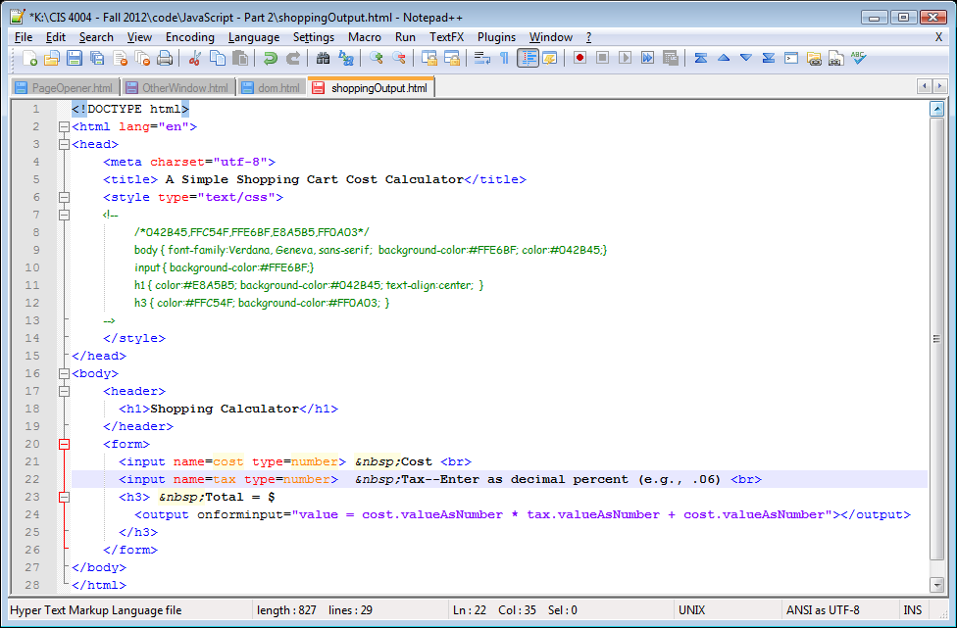

Slide 46
Write And Writeln
In order to output text in JavaScript we use:
write()
just outputs a text
writeln()
outputs the text and a line break.
<script language="javascript">
<!-- document.write("Welcome to my site!"); // -->
</script>

Slide 47
Other Methods
You can always include the last update date on your page by using the following code:
<script language="JavaScript">
document.write("This page created by Mr Lempogo. Last update:" + document.lastModified);
</script>
All you need to do here is use the lastModified property of the document.
Notice that we used + to put together This page created by Mr. Lempogo. Last update: and document.lastModified.

Slide 48
Other Methods
<!DOCTYPE html>
<html lang="en"> <head> <title> Temperature Convertor</title>
<style type="text/css">
body { font-family:verdana, geneva; background-color:#ffe6bf; color:#042b45; font-size:16pt; font-weight:bold;}
h4 {color:red; background-color:#ff0a03;}
</style></head><body>
<h1>this document includes some javascript</h1>
<hr>
<script language="javascript">
document.write ("Some info about this document:<BR>" +
"Title: " + document.title + "<BR>" +
"url: " + document.location + "<BR>");
document.write("Some info about the browser you are using:<BR>" +
"Name: " + navigator.appName + "<BR>" +
"Version: " + navigator.appVersion + "<BR>");
</script>
<hr>
<h4>this is below the javascript stuff</h4>
</body></html>

Slide 49
Using Message Boxes in JavaScript
There are three message boxes:
alert
confirm
prompt
The Alert Box
Used to display some output to the user
window.alert("Welcome to my site!");
Window.alert(“text1” + “\n”+ “text2”);

Slide 50
Using Message Boxes in JavaScript
The Confirm Box
Used to verify something
User clicks OK, Box returns true
User clicks Cancel, Box returns false
window. confirm("Are your sure?");
window.confirm("Are you sure you want to quit?");

Slide 51
More Examples
var x=confirm("Are you sure you want to quit?");
if (!x)
window.location="http://www.yahoo.com";
var x=window.confirm("Are you sure you want to quit");
if (x)
window.alert("Thank you.");
else
window.alert("Good choice.") ;

Slide 52
Using Message Boxes in JavaScript
The Prompt Box
Get user to input value
After inputting value if user clicks on
OK – the box returns input value
Cancel – the box returns null
prompt(“text”);
prompt(“text”, “default value”);
window.prompt("please enter user name");
var y=window.prompt("please enter your name“, “John”); window.alert(y);

Slide 53
Formatting Text…
document.write("<b>Hello World!</b>");
document.write("<h1>The heading </h1>");
document.write("<b> regular HTML text </b><br><br>");

Slide 54
Any Questions?

